Slide 1
100% IST Instructions
(OmeGEB route)
# Overview
These are just the instructions for IST. See the celer route for prep steps and for the later WMC instructions.
You may also view these steps in the simulator.
This setup does the following:
* Drop korok seeds
* Dupe and corrupt (get 999 of) most materials necessary for quests and upgrades
* Dupe many stamina meals
* Corrupt five types of arrows: normal, fire, ice, bomb, and ancient

Slide 2
100% IST Instructions
# Autosaves
Two plateau autosaves must be protected by system clock manipulation:
In SoR right after the beginning of the game.
Running to the boko camp after getting the axe.
# Breaking Slots (Arrowless)
See Player5's IST tutorial for how to break slots without menu overloading.
https://youtu.be/NZBmu9hEZY0f
# Corruption Reminder
In corruption steps, if there's a save after a reload, do not do anything else in between those steps. This includes unpausing or using the quick menu.

Slide 3
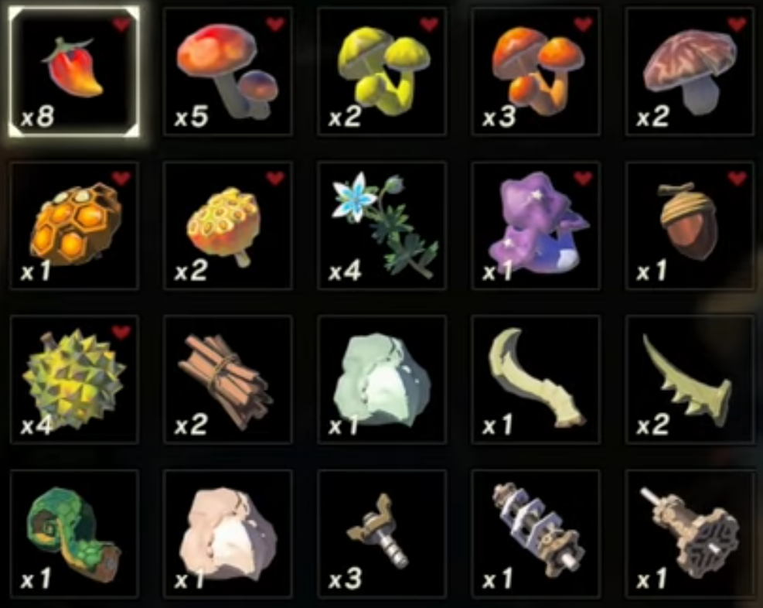
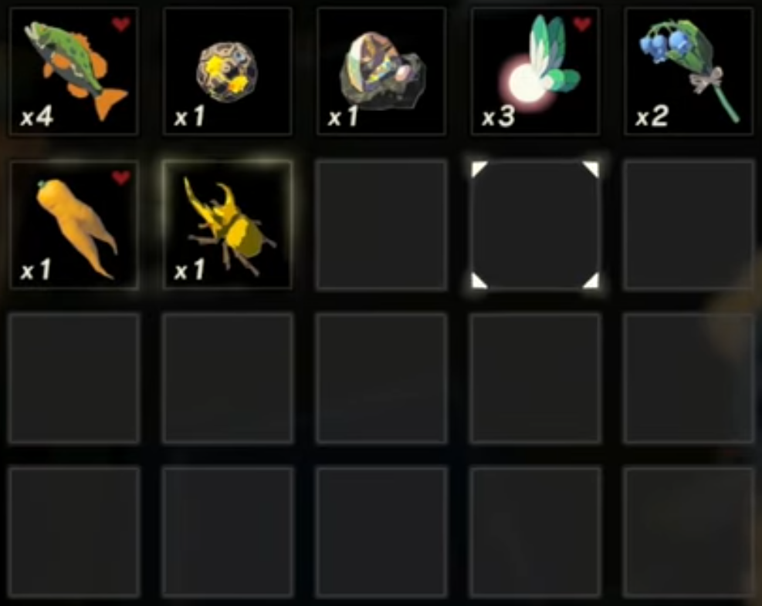
100% IST Instructions
# Starting Inventory
Here is an example of a starting materials inventory. Excess equipment, materials or food should be dropped or eaten. DO NOT get more types of arrows, more spirit orbs, koroks or other key items.
As long as you acquire the items in the order listed on the route doc, everything should be in the right order. The order of scrap materials does not matter. It is okay to have extras of the scrap, but not of most other materials. The order you pick up the lizalfos parts and guardian parts also doesn’t matter. Scrap can be anything, so for example if you have to eat your 3 durians, you can just grab 3 apples near Impa’s house to replace them.

Slide 4
Break Slots (12)
Break 4 Slots
* Zapshroom, Razorshroom, Wood, Nightshade
* Spring check item
* Pick up IN THIS ORDER:
Nightshade, Spring, Wood, Zapshroom,
Razorshroom (eat Razorshroom)
Drop 1 each of:
Pepper, Shroom, Sunshroom, Durian
Break 4 Slots
* Pepper, Shroom, Sunshroom, Durian
* Honey check item
Pick up both piles of materials
Break 4 Slots
* Pepper, Shroom, Sunshroom, Durian
* Zapshroom check item
Leave the shop without picking up items

Slide 5
Dupe 1
Drop/Pickup:
* Rushroom + all Screws + Carrot
* 4 HyruleBass
* 2 Lotus Seeds + both Fangs
* 2 Talon + Horn + Shaft
SAVE
LOAD Shrine of Resurrection
Shrine of Resurrection
Get Invalid Star Tab
LOAD Hard Save

Slide 6


Dupe 2
Sort Key Items
Drop both slots of 5 Korok Seeds:
Cursor on materials page 2 row 2 col 5
(wait a second)
repeat
Drop/Pickup:
* 4 Fish
* Horn + 2 Talon
* 2 Lotus + Shaft
* 4 Princess
SAVE
BREAK 2 ADDITIONAL SLOTS
* Hold 2 fairies, stand in fire until a fairy is used, spam A to drop and pick up fairies
* Hold 1 fairy, stand in fire until fairy is used, press A to drop fairy
LOAD Hard Save

Slide 7
Dupe 3
Drop/Pickup:
* 8 Fish + 2 Horn
* 4 Princess + 4 Lotus
* Fangs (in 4 slots) + 2 shaft
* 4 Talon
SAVE
LOAD Hard Save

Slide 8
Dupe 4
Drop/Pickup:
* 8 Talon
* 4 Horn + 4 Shaft
* 8 Princess
Turn in all orbs at the statue:
10 stamina
6 hearts
Drop PotLid and Sword if you have them (only boko club/claymore, FDB/Falcon, 4 arrow types, Hylian Shield)
Equip
* Claymore (slot 2)
* Forest Dweller Bow (slot 1)
* Ice Arrows
* Hylian Shield
SAVE
LOAD Boko Camp Autosave

Slide 9
Corruption 1
* If a weapon is equipped on your Plateau save, be sure to unequip it EVERY time you load that save.
Plateau
Eat 3 Food
LOAD Hard Save
Kakariko
SAVE
LOAD Hard Save
Arrow Shop
Drop acorn + 5 cores, sell 994 cores, pick up 5 cores + acorn
Equip Falcon Bow & Boko Club
SAVE
LOAD Boko Camp Autosave

Slide 10
Corruption 2
Plateau
Eat 7 Food
LOAD Hard Save
Kakariko
Shoot arrow
SAVE
LOAD Boko Camp Autosave

Slide 11
Corruption 3
Plateau
Eat 6 Food
LOAD Hard Save
Kakariko
Shoot arrow
SAVE
LOAD Hard Save
Buy 1 fire arrow
Equip ancient arrows
But Swift Carrot (other shop)
Sort Materials
SAVE
LOAD Boko Camp Autosave

Slide 12
Corruption 4
Plateau
Get boko spear from camp
Equip torch
Eat 9 Food
LOAD Hard Save
Kakariko
Shoot arrow
SAVE
LOAD Hard Save
Continue from the route doc.
DO NOT reload any saves until after WMC is finished.

Slide 13

WMC Meal
BTB to Link’s House (Hateno)
Drop Endura Carrot, Nightshade, burn with fire arrow
* Pick up roasted carrot
Talk to Bolson
SAVE
LOAD Hard Save
COOK Speed Food (1 Din. Fang, 4 Lotus)
Eat 7 endura meals
SORT MEALS TWICE
Hold Roasted Carrot
* Cursor on meals tab 1 row 3 column 5
(wait a
moment)
Unpause/pause, hold 3 fairy + princess
Cook WMC meal (sneaky fried wild greens)
Eat 2 endura meals
SAVE
LOAD Hard Save

Slide 14
Continue to Medoh
Eat speed food
Follow the route up thru completing Vah Medoh
* Hateno/Necluda stuff
* Farosh farming + Faron
* Hestu 1 & 2
* Tabantha Tower, Rito Village 1
Complete Vah Medoh, destroy Windblight, get Revali’s Gale
BEFORE GETTING GEB FROM CHEST:
* Unequip bow
* Equip fire arrows
Get GEB from chest by Rito Chief

Slide 15
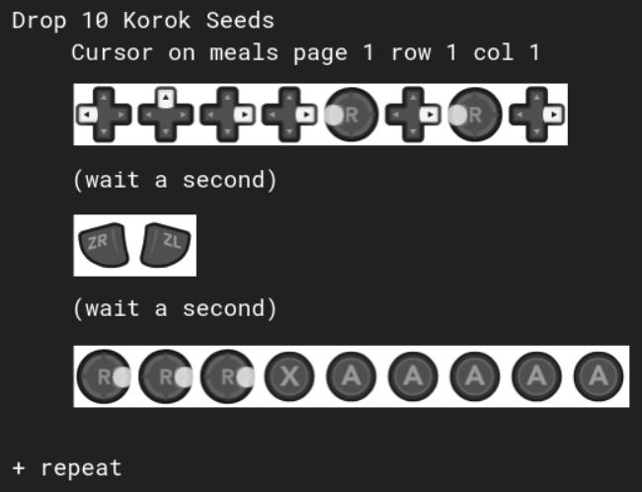
WMC Prep 1
* Drop to cookpot
* Take pot lid (equip Hylian Shield)
* Ensure you have 41 meals (eat if you haven’t already)
* Cook speedfood
(Farosh Horn + 3 Lotus Seeds + Rushroom)

Slide 16



WMC Prep 2
Eat your Sheikah Slate:
Cursor on meals page 1 row 1 col 1
(wait a second)
(wait a second)
* Sell or drop all materials except:
* Farosh Scale
* Hearty Bass
* Eat all meals except for the last two
(baked apple + speedfood)
* Drop boko club

Slide 17
WMC 1
Drop Forest Dweller Bow and Falcon Bow
Drop Claymore + Potlid
Drop Fish + Scale
IN ORDER pick up:
* Claymore
* Fish
* Scale
* Potlid
SAVE
Pick up Bows
Drop Fish + Scale
Eat both meals
LOAD Hard Save

Slide 18
WMC 2
Shoot arrow
SAVE
Unequip 2nd GEB
Equip Ancient Arrow
Equip 2nd Potlid
Drop Fish + Scale
Eat speedfood
LOAD Hard Save
Shoot arrow
SAVE
Drop last 2 shields
Eat fish
LOAD Hard Save

Slide 19
WMC 3
Unequip Claymore
Unequip Bow 2
Drop Bow 3
Drop Shields 1, 2, 4
Unequip Shield 3
Drop/Pickup Scale
Eat first 2 meals
LOAD GEB Autosave
* if you’re concerned about bow durability, you can instead unequip all bows and drop bow 1. This will give an extra 800-durability normal GEB.

Slide 20
Results
Equip:
* Claymore in slot 1
* OmeGEB in slot 2
* Hylian Shield in slot 1
Continue from route doc.

